Slide 1
USED CAR PRICE
JUNGU KANG

Slide 2
Objective
To find the best model for predicting a used car price
70% training set – 30% test set
Language: R
Method: Multiple Linear Regression

Slide 3
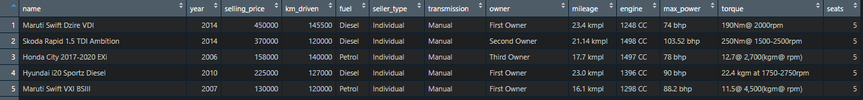
Dataset
From Kaggle
https://www.kaggle.com/nehalbirla/vehicle-dataset-from-cardekho
Target: Selling Price
Features: Year, km, Fuel Type, Seller Type, Transmission,
nth owner, Mileage, Engine, Max Power, Torque, Seats

Slide 4
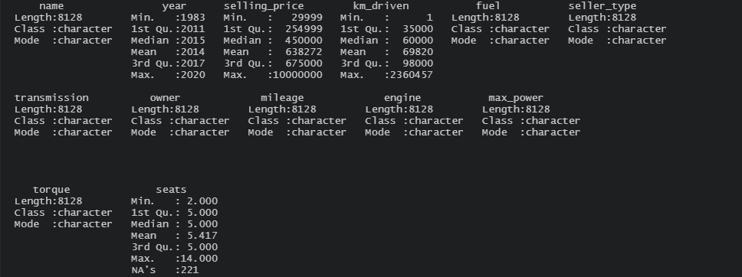
Preprocessing
Some rows are outliers or NA
After filtering, the observations become 8128 -> 7885

Slide 5
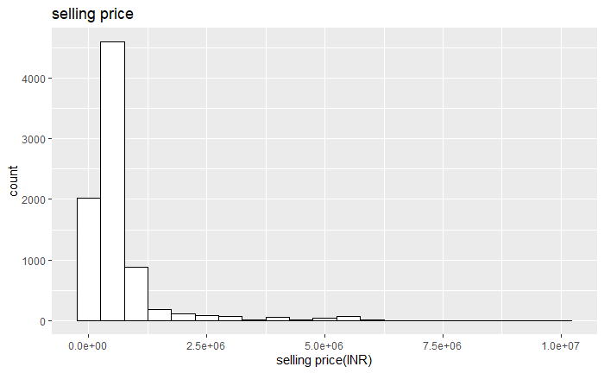
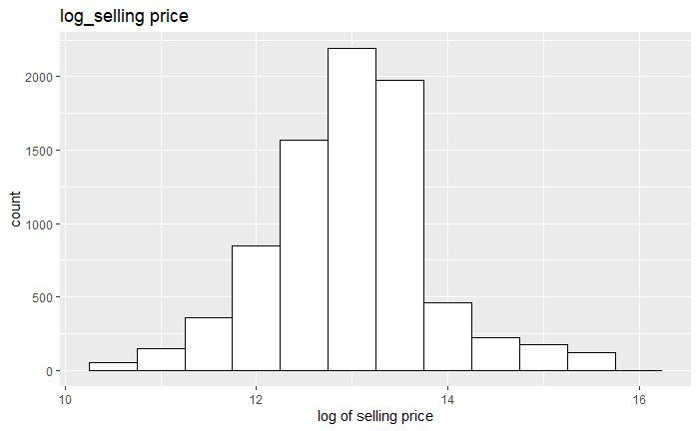
VISUALIZATION
Histogram of selling price
Original vs logarithm

Slide 6
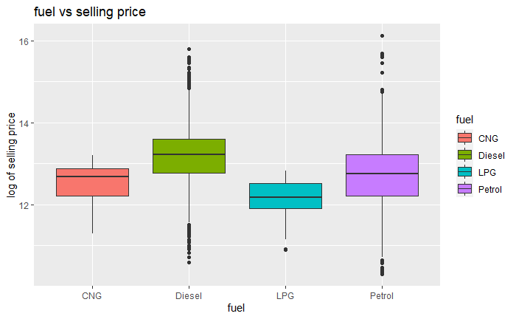
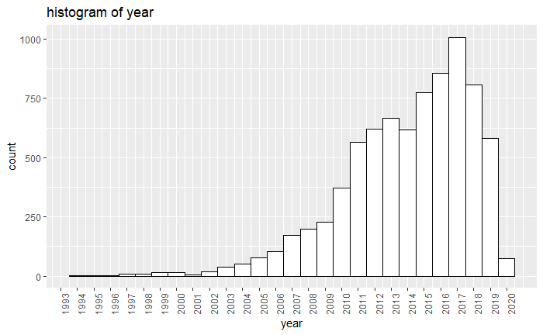
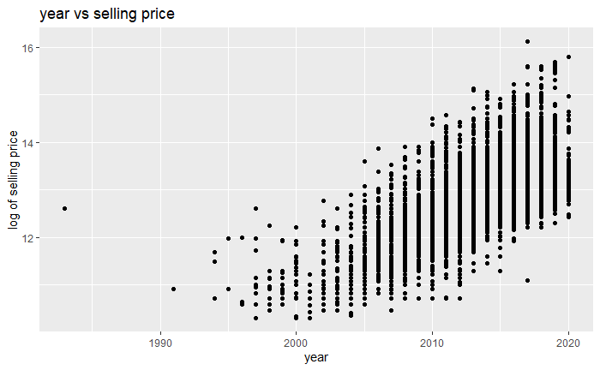
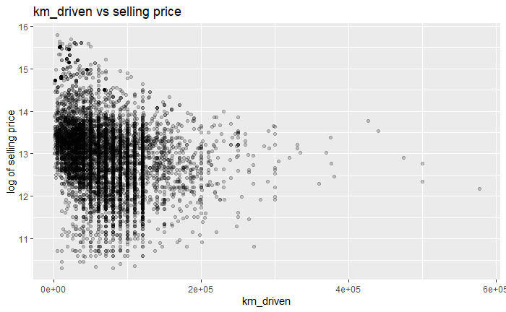
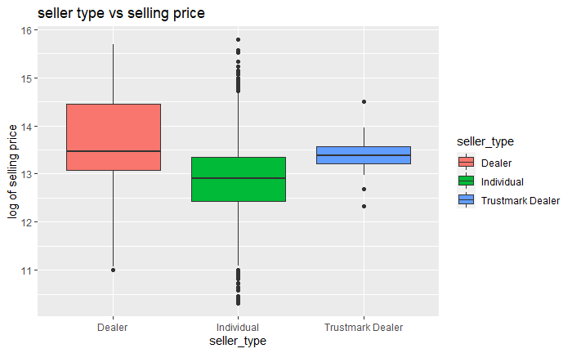
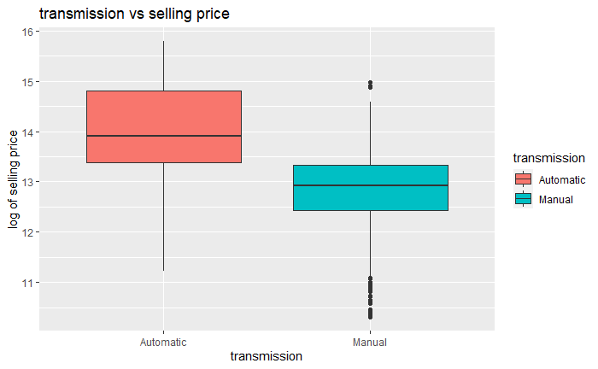
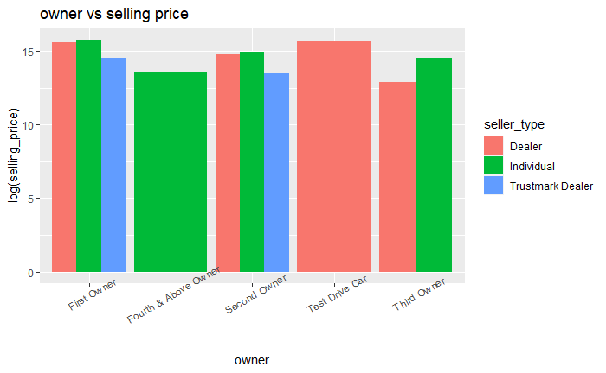
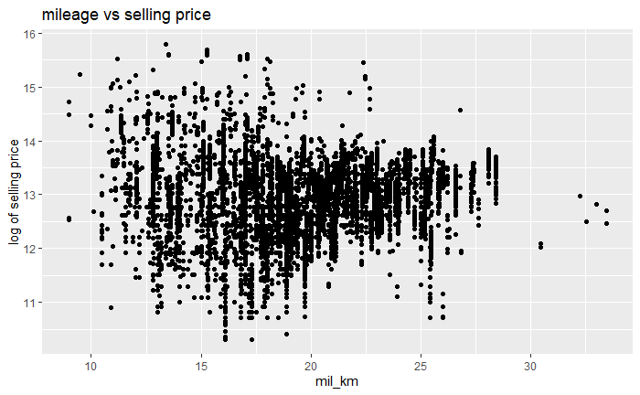
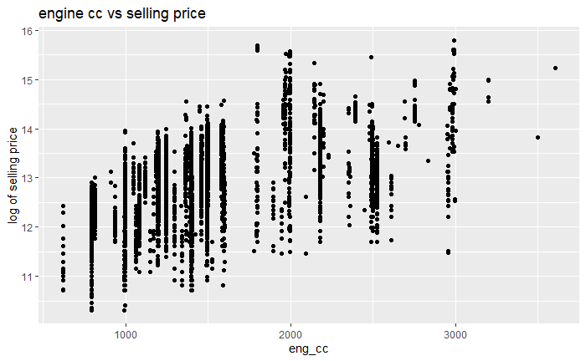
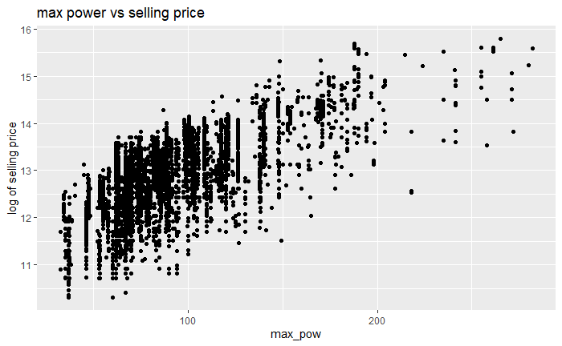
VISUALIZATION
Log of selling price vs other features
Graphs are available in RShiny

Slide 7
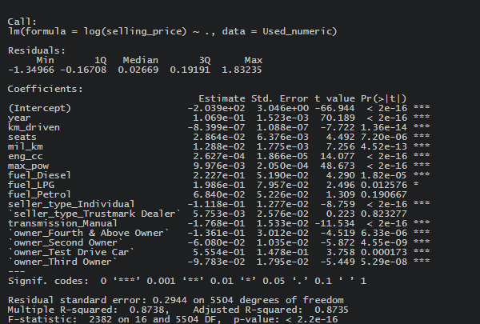
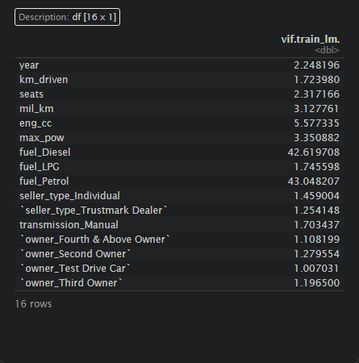
Multiple linear regression
Take a 70% train, 30% test set for Multiple Linear Regression
Perform dummify for categorical variables in the test set
VIF scores for multicollinearity check

Slide 8
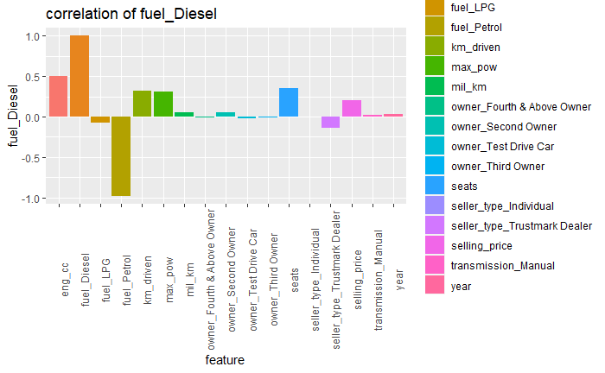
Multiple Linear Regression
Correlation of fuel_Diesel

Slide 9

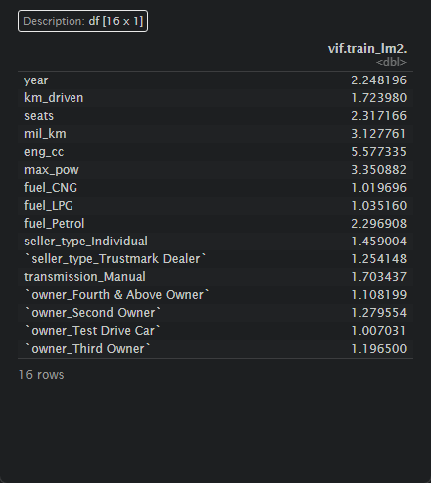
Multiple linear regression
Change dummify for fuel variable as from DIESEL to CNG
Since DIESEL has a big correlation with Petrol, replace it to CNG

Slide 10
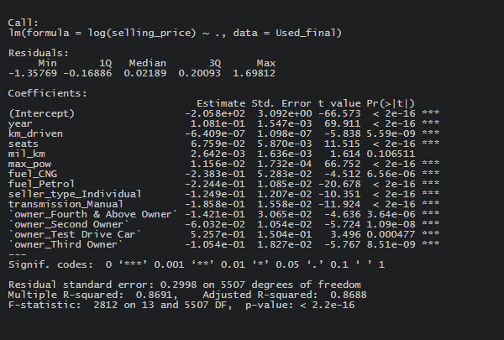
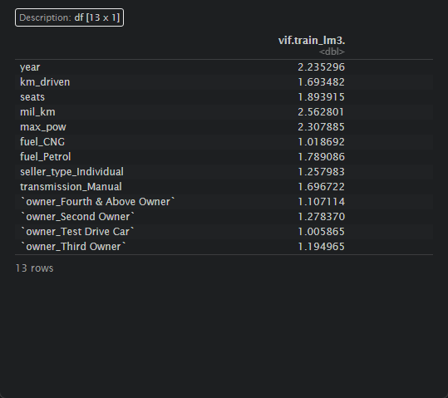
Multiple Linear Regression
Model 2: no engine cc
Take out the features having VIF higher than 5

Slide 11
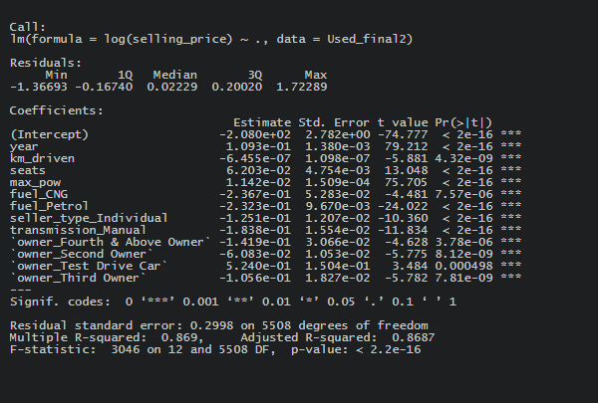
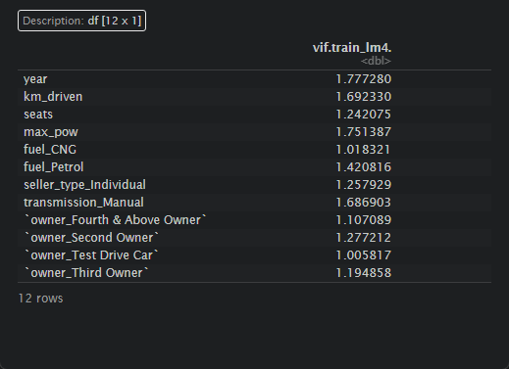
Multiple Linear Regression
Model 3: take out features having p-value >0.05

Slide 12
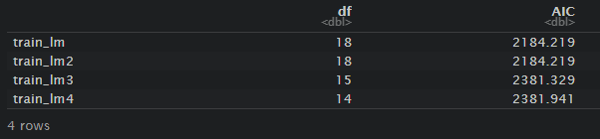
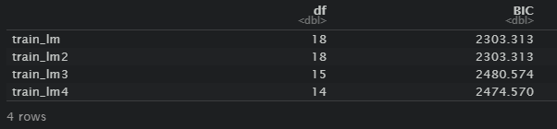
AIC, BIC
Model
train_lm: all variables
train_lm2: all variables with adjusted dummify selection for fuel variable
train_lm3: removed eng_cc that has VIF score higher than 5
train_lm4: removed mil_km that has p-value higher than 0.05

Slide 13
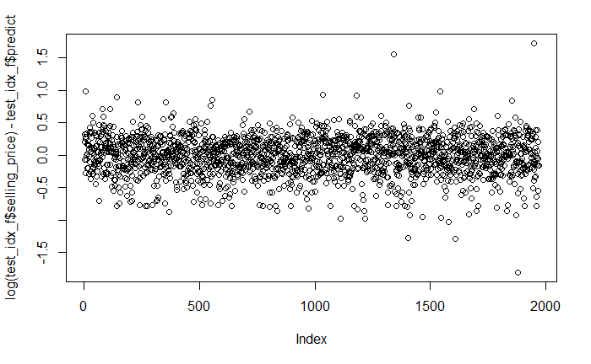
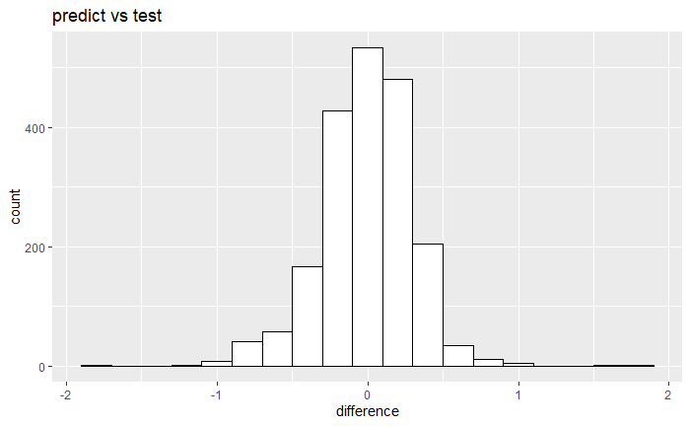
Test set
Standard error: 0.379
Predicted R square score: 0.868

Slide 14
Summary & Future study
Original selling price was skewed, so logarithm was applied.
After checking the linear regression assumptions and AIC, BIC scores, the best regression model was chosen as train_lm4.
The prediction with the model gives 0.868 of the predicted r square score to the test dataset.
------------------------------------------------------------------------------------------------------
Using different regression models such as RandomForestRegressor may conclude a better result

Slide 15
Questions?
Thank you for listening!

